Slide 1
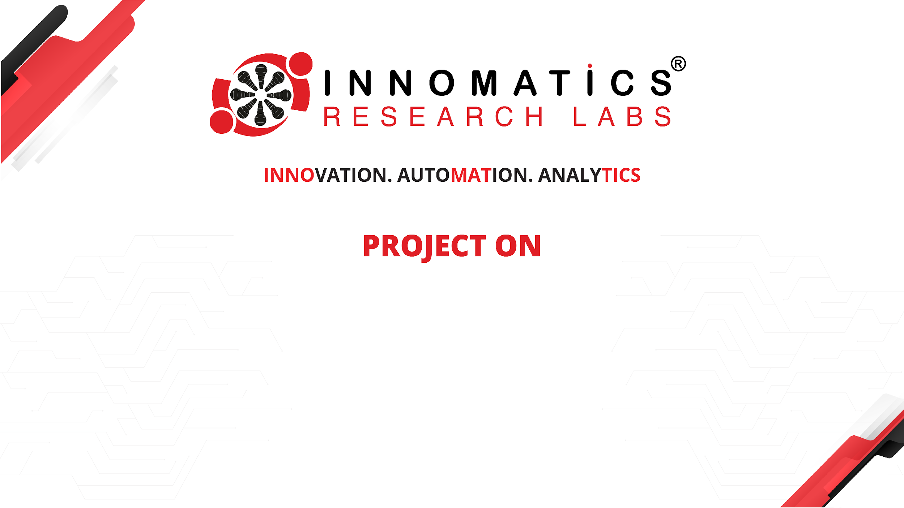
Exploratory Data Analysis of AMEO Dataset
Repana Jyothi Prakash (IN9240346)
26th September 2024

Slide 2
About me
Hello everyone, I’m Jyothi Prakash, a passionate and ambitious graduate with a Bachelor's degree in Information Technology.
While my academic journey initially focused on foundational concepts, I took proactive steps to independently develop expertise in software development, data science, machine learning, and data analysis.
Entering the dynamic field of data science, machine learning, and data analysis as a self-motivated learner,
I am eager to leverage my acquired skills and knowledge to contribute to innovative projects and tackle complex challenges.
In addition to my software development skills, I possess a keen interest in data science and analytics. Through self-directed study and practical application, I explored various facets of data analysis, including data visualization, statistical analysis, and machine learning algorithms. I am adept at utilizing libraries such as Pandas, NumPy, Matplotlib, and Scikit-learn to extract insights from data and construct predictive models.
I am excited about the prospect of applying my skills in software development and data science to real-world projects. Whether it's developing software applications, conducting data analysis, or implementing machine learning solutions, I am eager to make a meaningful impact and contribute to the advancement of technology.
As I embark on this new chapter in my career, I am open to exploring opportunities that will allow me to further develop my skills and gain hands-on experience in software development, data science, and machine learning. I am committed to continuous learning and growth, and I look forward to the challenges and opportunities that lie ahead.

Slide 3
Business Problem
Overview
The employment landscape for engineering graduates is multifaceted, with salary outcomes influenced by various factors such as skills, job titles, locations, and demographics. Aspiring Minds' AMEO dataset offers valuable insights into these factors, providing a foundation for understanding and optimizing salary outcomes
Specific Challenges
Solution
Complexity of Factors: Interplay between cognitive skills, technical expertise, personality traits, job titles, and locations complicates salary determinants.
Data Variability: Diverse variables (continuous and categorical) necessitate detailed analysis for meaningful patterns.
Predictive Modelling: Accurately estimating salaries considering dynamic market factors is challenging.
Conduct thorough EDA and feature engineering, apply advanced ML algorithms for predictive modelling, and translate insights into actionable recommendations for improved employability and salary negotiations.

Slide 4
Use Case Domain Understanding
Overview
The use case domain revolves around understanding employment outcomes and salary determinants specifically tailored for engineering graduates. It encompasses a range of factors that influence salary outcomes, including skills, job titles, locations, demographics, and industry trends.
Importance
Key Components
Strategic Decision-Making: Informed decisions in recruitment, talent management, and career development.
Competitive Advantage: Enhances talent acquisition and retention strategies.
Career Development: Guides graduates in negotiating better salaries and enhancing employability.
Salary Determinants: Factors impacting salaries like skills, job roles, industries, and locations.
Employment Trends: Analysing industry-specific trends and emerging roles.
Skill Enhancement: Recommending skill development and career advancement opportunities.
Salary Negotiation: Providing tactics for effective salary negotiation.

Slide 5
Objective of the Project
The project aims to delve into the factors influencing salary outcomes for engineering graduates using the Aspiring Mind Employment Outcome 2015 (AMEO) dataset. The primary objectives are to identify key determinants of salary, develop predictive models for salary estimation, and provide actionable recommendations for skill enhancement and career advancement.
Identify Key Salary Determinants: Explore cognitive skills, technical expertise, personality traits, job titles, locations, and demographics influencing salary outcomes. Uncover correlations and patterns within the dataset to understand the impact of these factors.
Provide Actionable Recommendations: Translate analysis findings into actionable insights and recommendations. Offer strategies for skill enhancement, training programs, certifications, and career growth tailored to engineering graduates.
Enhance Employability and Salary Negotiation: Empower engineering graduates with the knowledge and tools to negotiate competitive salary packages. Facilitate career development and improve employability in the dynamic job market.

Slide 6
Project Overview
Overview
The project aims to analyse the factors influencing salary outcomes for engineering graduates using the Aspiring Mind Employment Outcome 2015 (AMEO) dataset. Key objectives include identifying salary determinants, developing predictive models, and providing actionable recommendations for career enhancement.
Key Components
Actionable Insights: Translate analysis findings into actionable recommendations for skill enhancement, career development, and salary negotiation strategies tailored to engineering graduates.
Data Collection: Obtain and preprocess the AMEO dataset containing information on cognitive skills, technical expertise, personality traits, job titles, locations, demographics, and salary outcomes.
Exploratory Data Analysis (EDA): Conduct thorough EDA to uncover correlations, trends, and patterns related to salary outcomes and key influencing factors.

Slide 7
Summary of the Data
Dataset Overview:
Total data points: 3,998
Variables: 39 columns, including ID, Salary, Date of Joining (DOJ), Date of Leaving (DOL), Designation, Job City, Gender, Date of Birth (DOB), academic performance (10th and 12th percentages), college details (college ID, tier, state), degree information, specialization, GPA, graduation year, and various skill scores (English, Logical, Quantitative, Domain, Computer Programming, etc.).
Key Data Insights:
Salary Distribution: Variability in salaries based on designations, job cities, and specialization areas.
Demographic Impact: Gender differences, academic background influence on salary prospects.
Skill Scores Analysis: Correlation between skill scores (English, Logical, Quantitative, etc.) and salary outcomes.
Personality Traits: Influence of personality traits (conscientiousness, agreeableness, etc.) on job roles and salary levels.
Data Cleaning and Preprocessing:
Handling Missing Values: Utilized imputation techniques for missing data in certain columns.
Removing Duplicates: Ensured data integrity by removing duplicate entries.
Standardization: Standardized data formats and encoded categorical variables for analysis.
Outlier Detection: Identified and addressed outliers in relevant columns for accurate analysis.

Slide 8
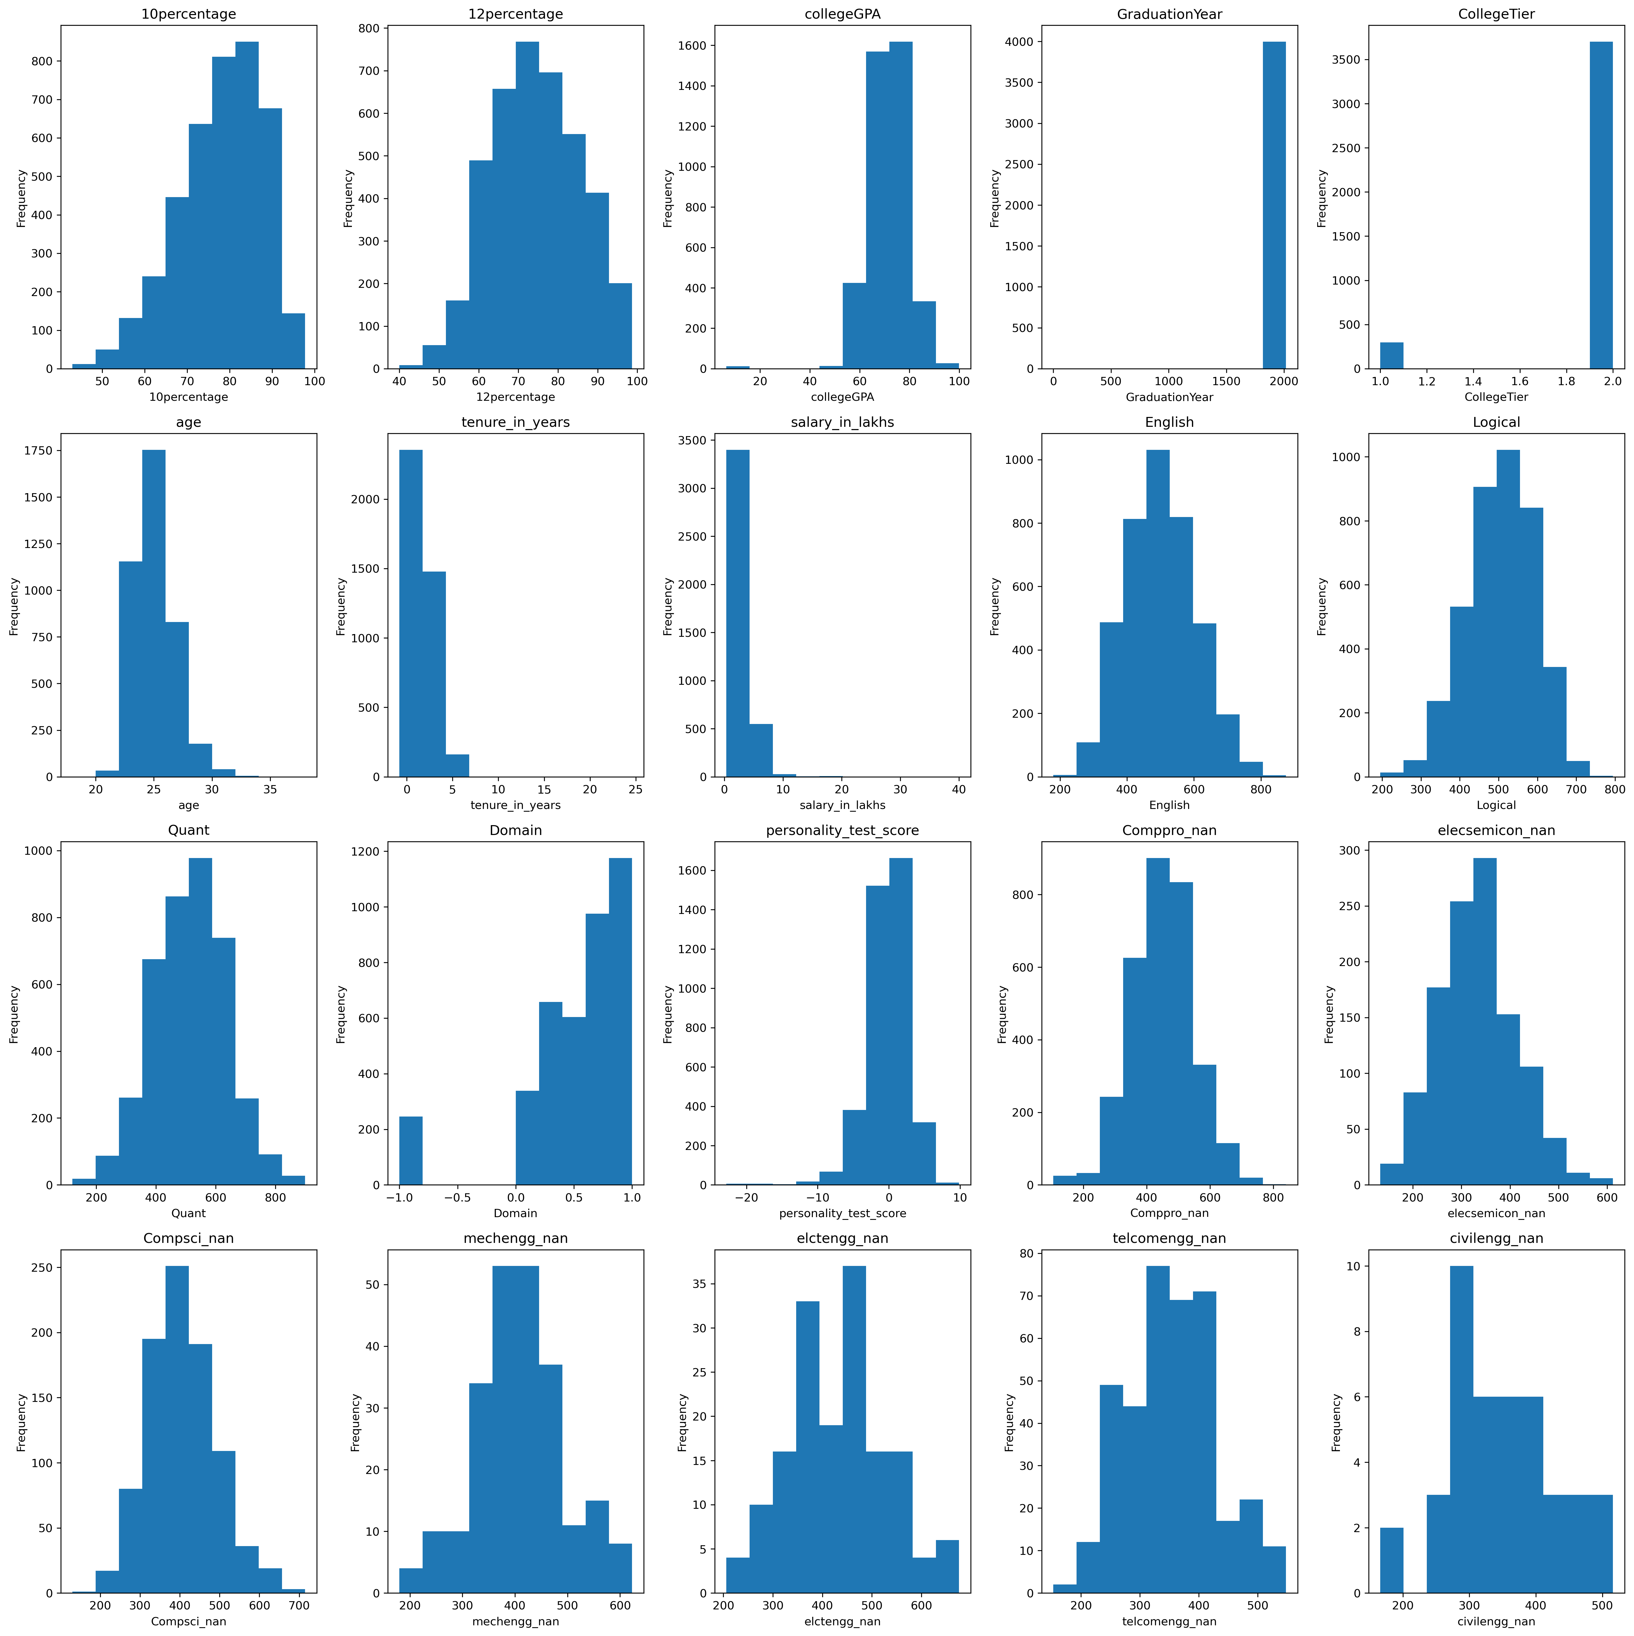
Univariate Numerical Variables Distributions
Histograms of various numerical columns present in the dataset

Slide 9
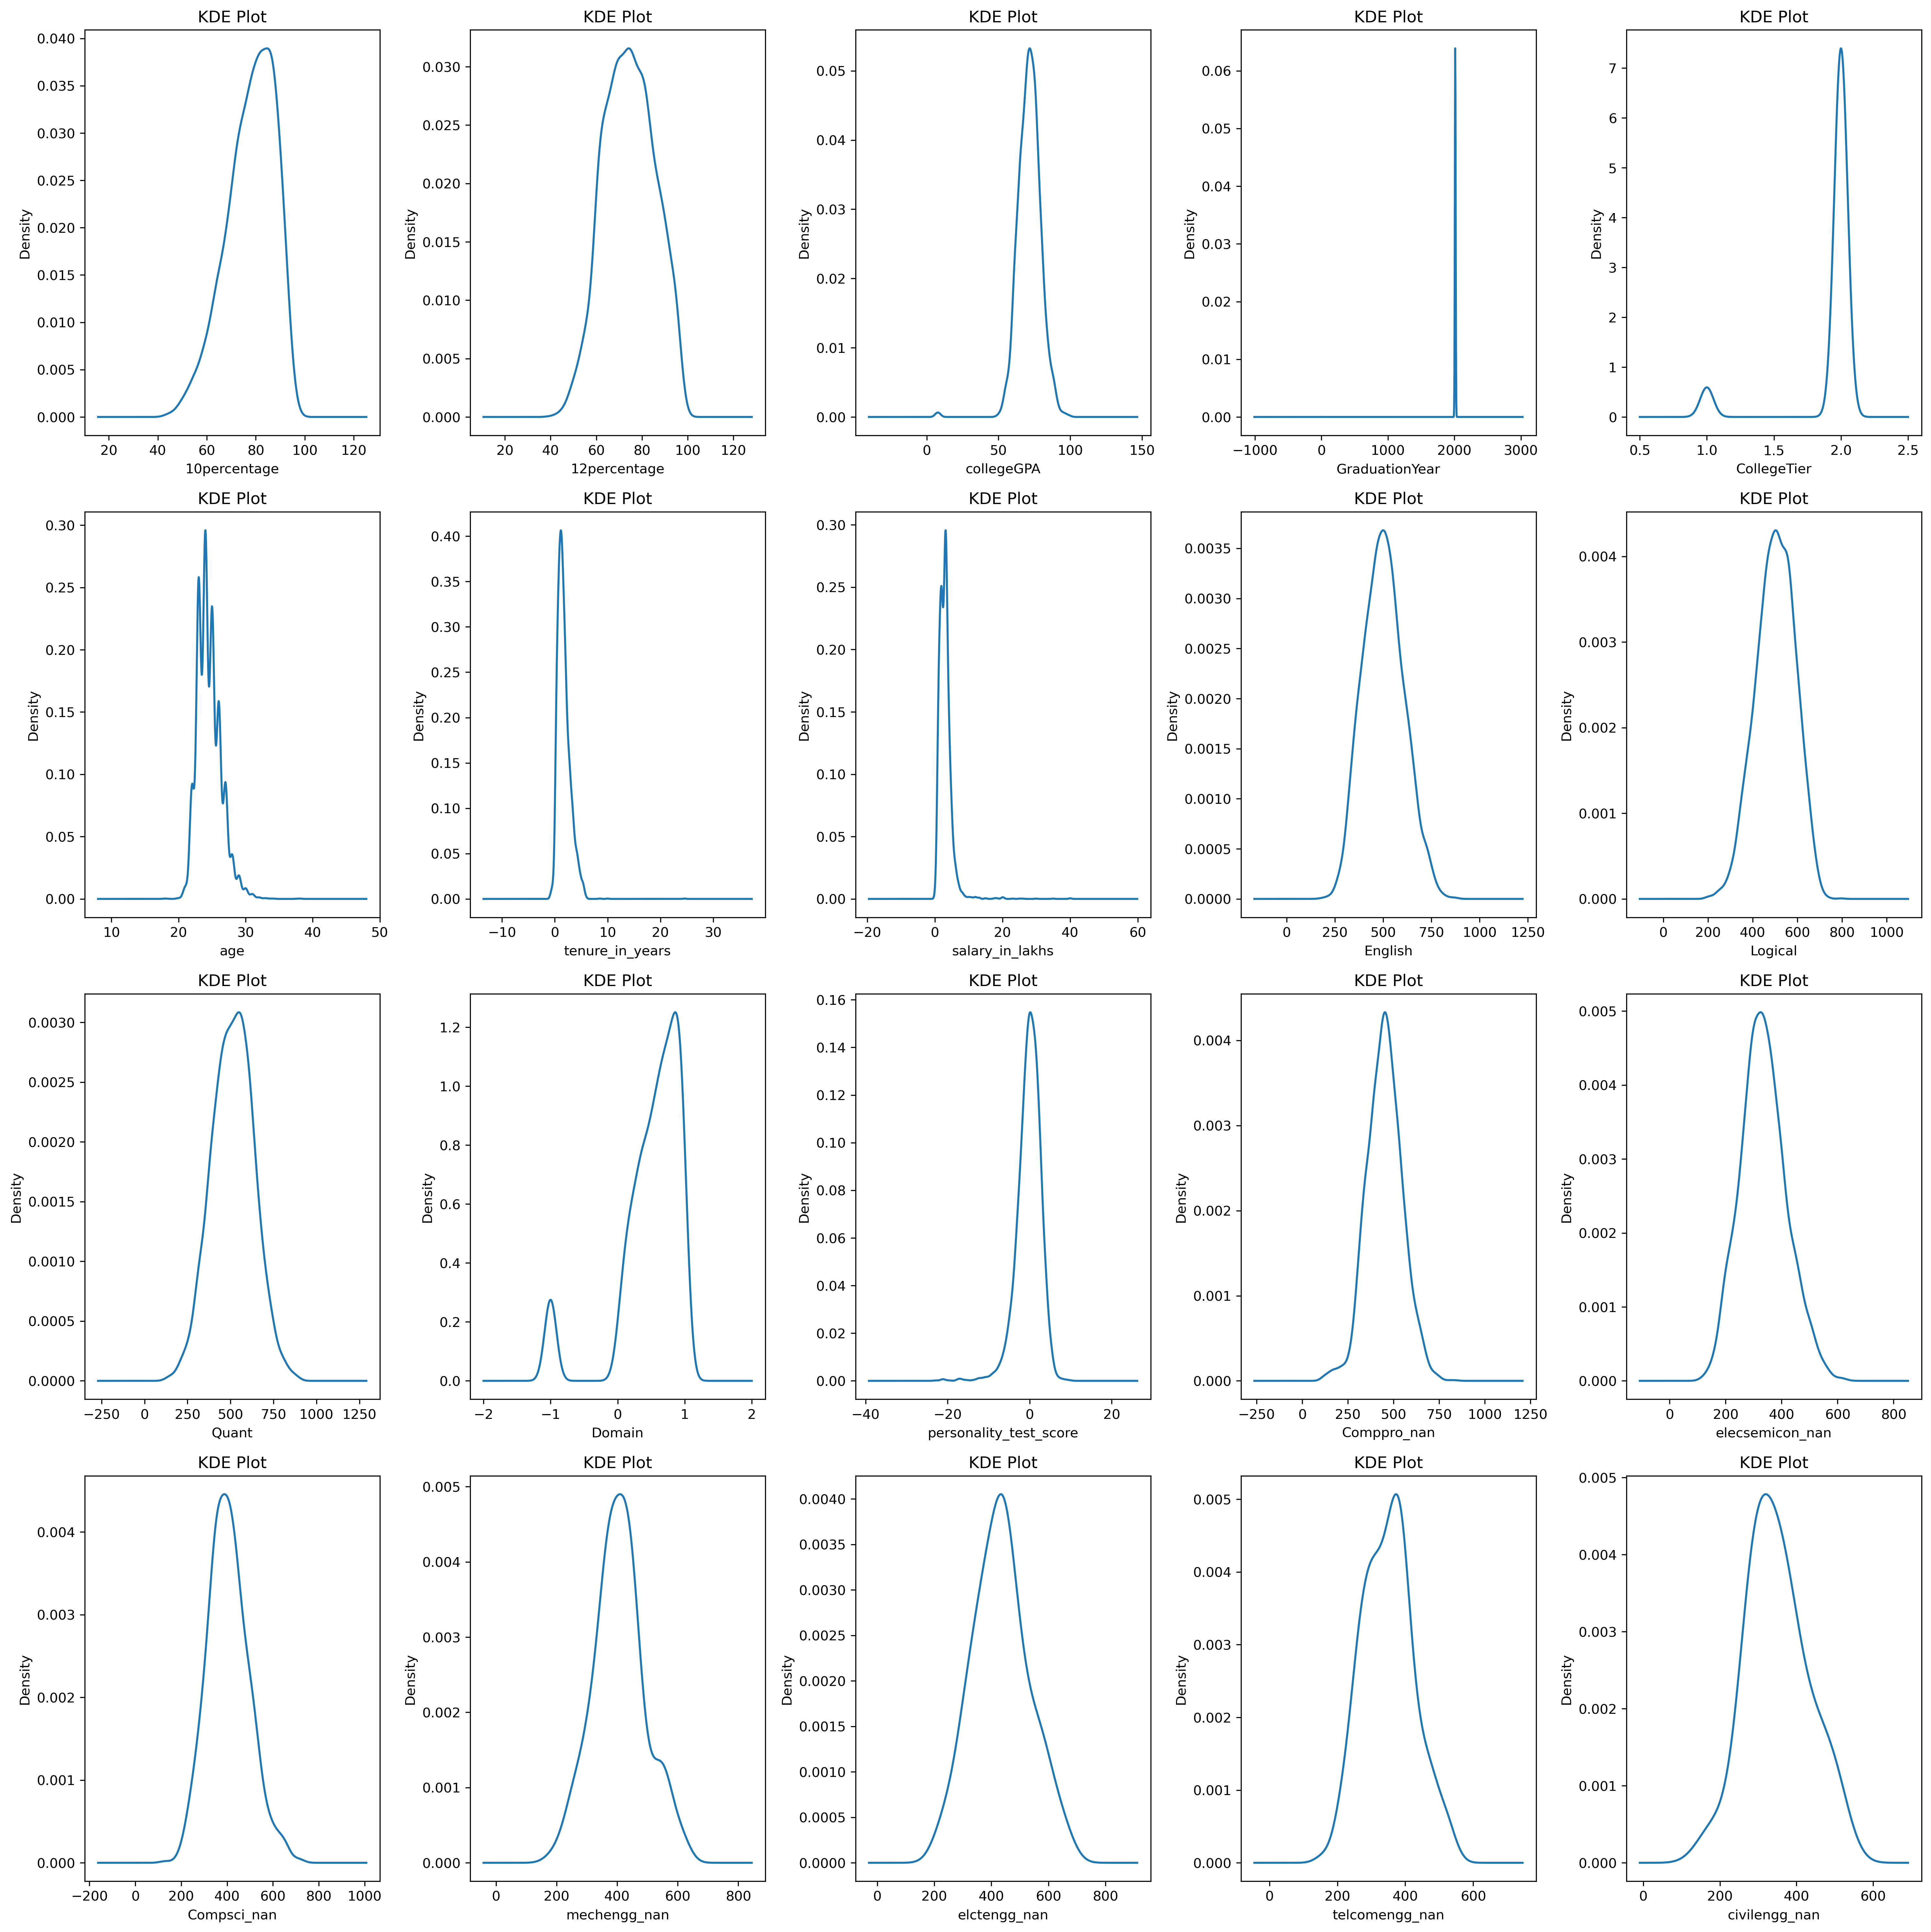
Univariate Numerical Variables Distributions
KDE of various numerical columns present in the dataset

Slide 10
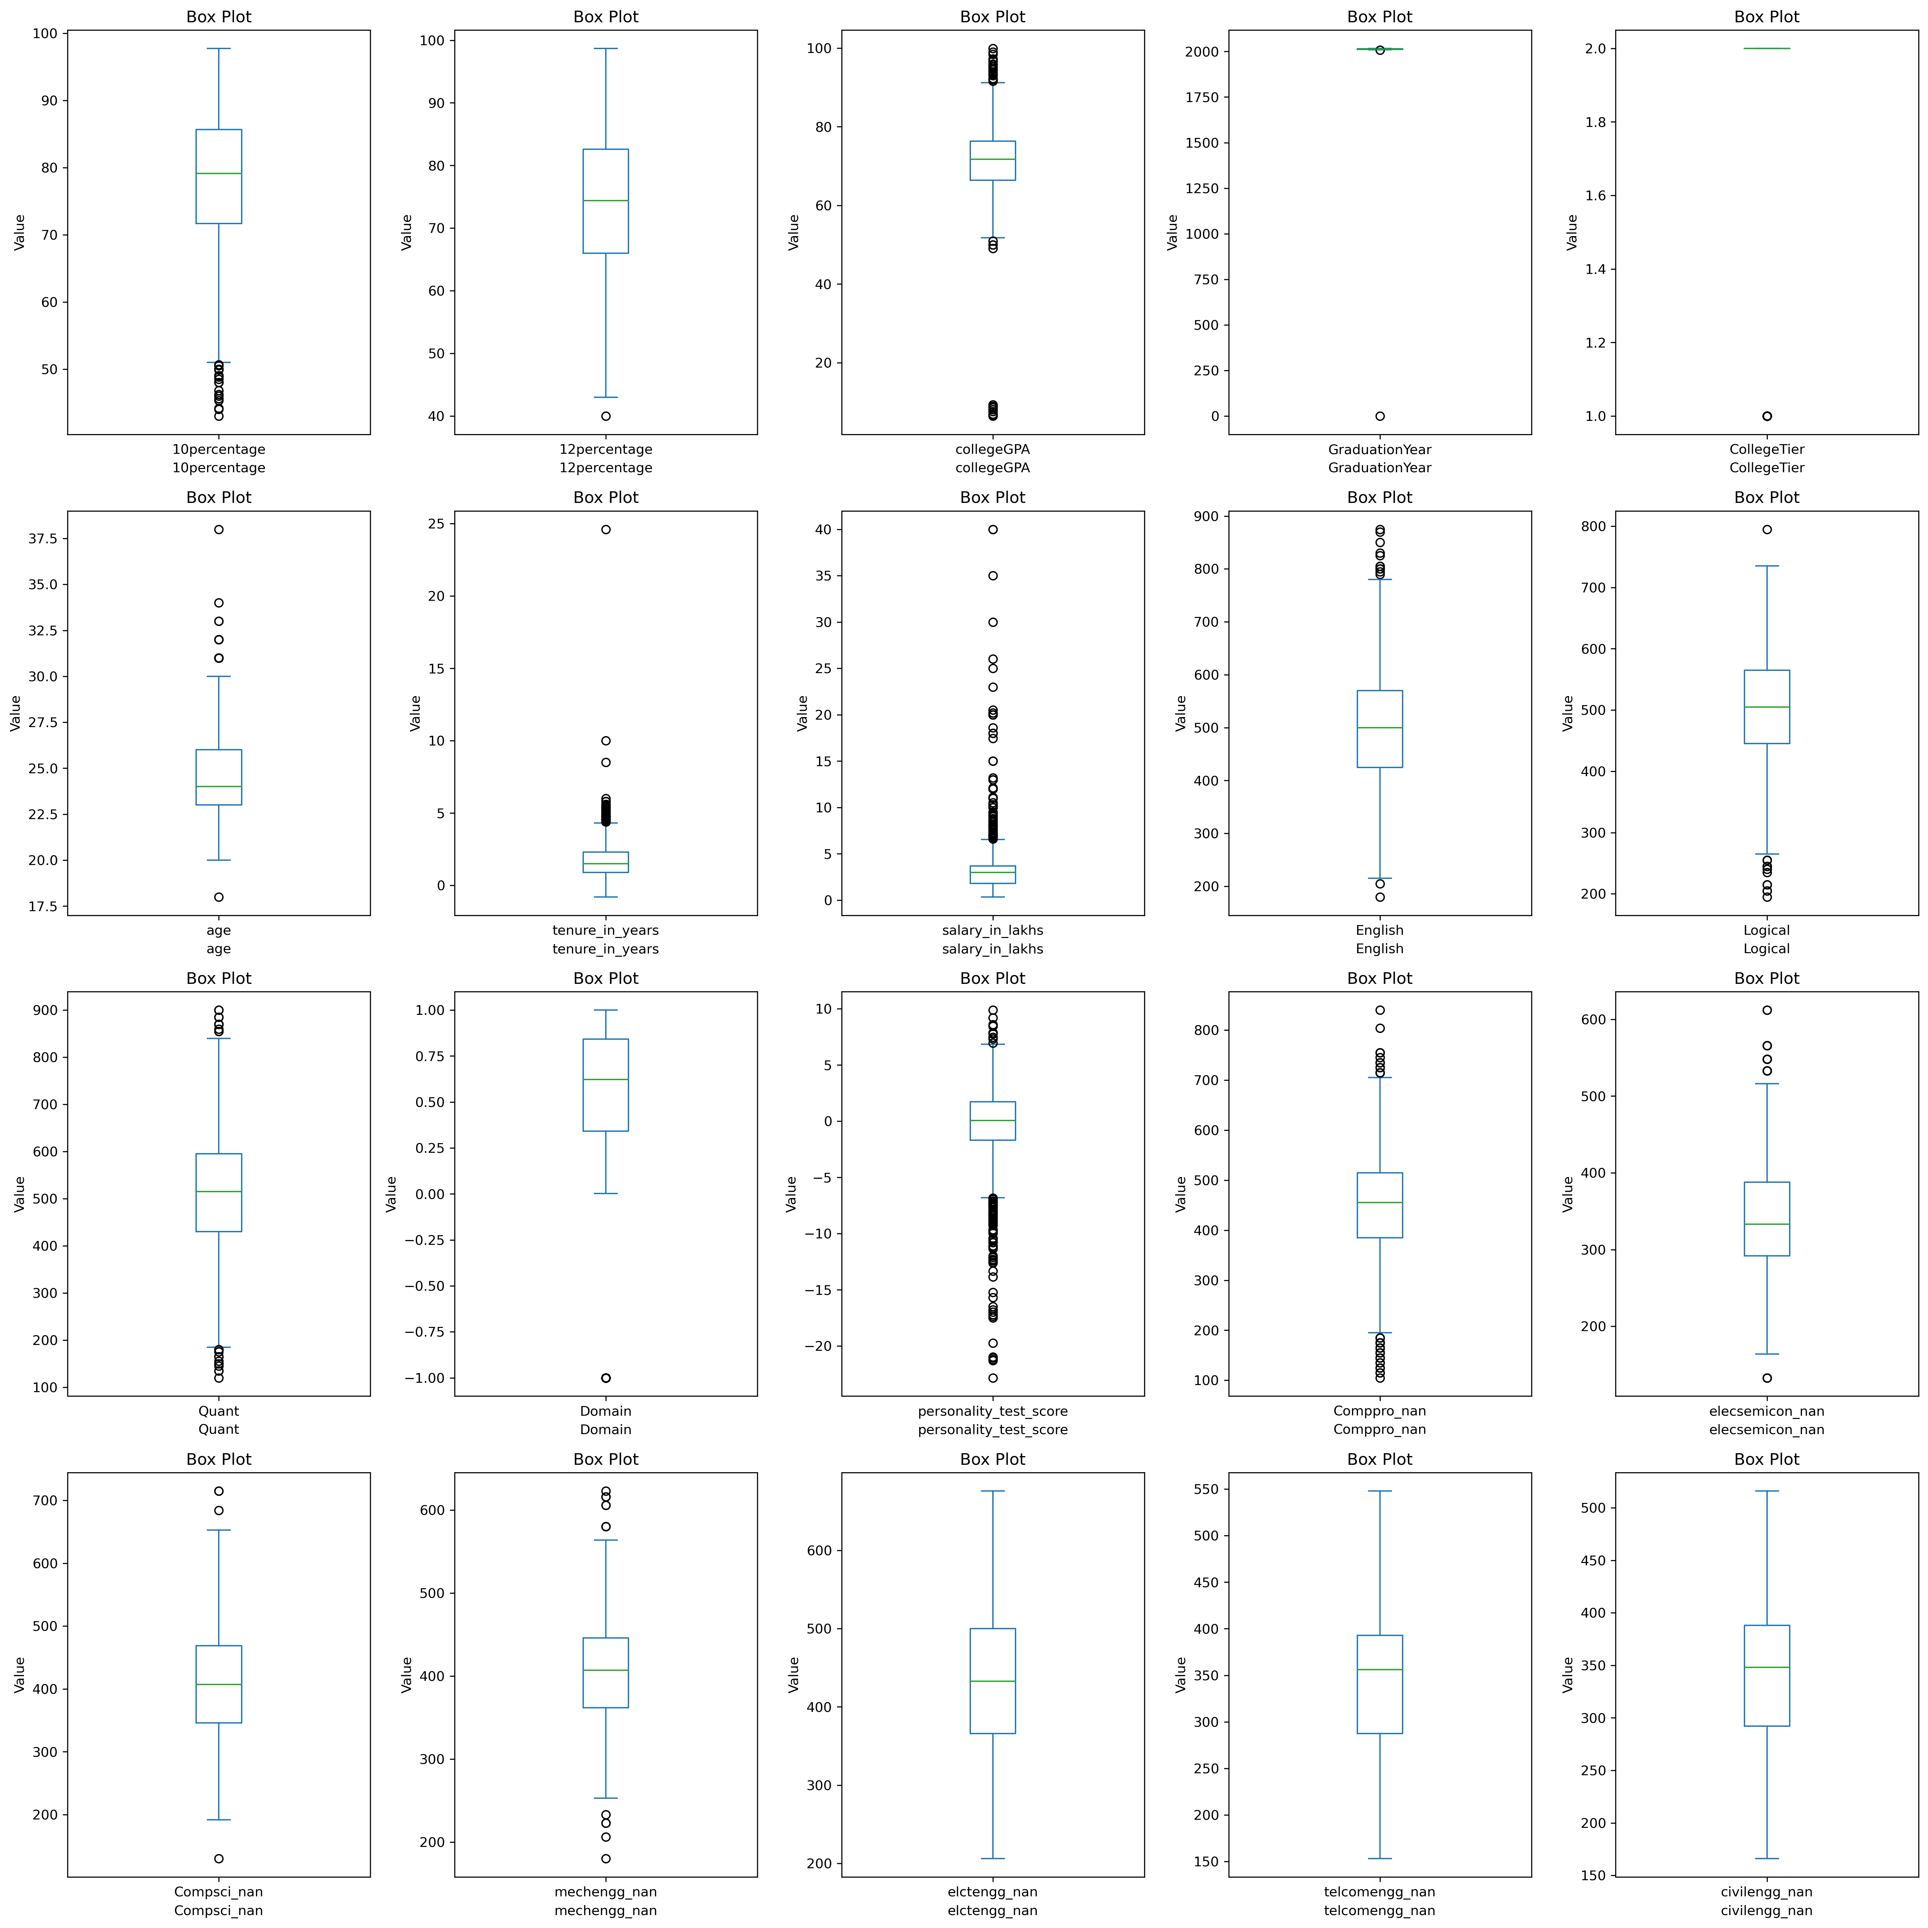
Univariate Numerical Variables Distributions
Box plots of various numerical columns present in the dataset

Slide 11
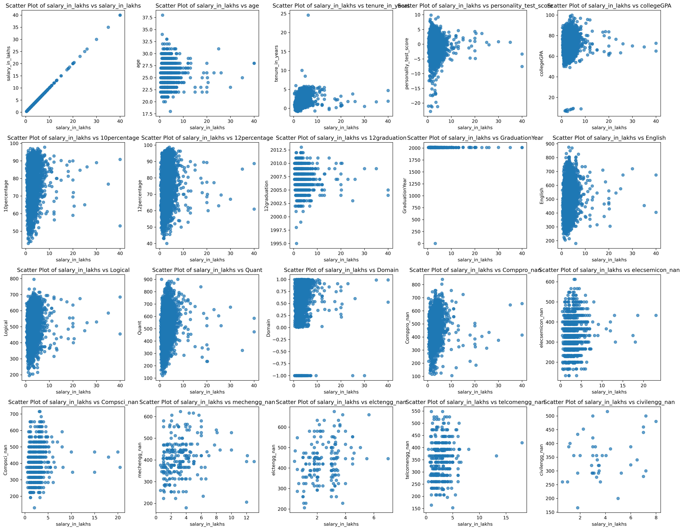
Various Features & Their Relationships With The Target Variable, Salary
Bivariate Analysis Of Salary With Other Numerical Variables

Slide 12
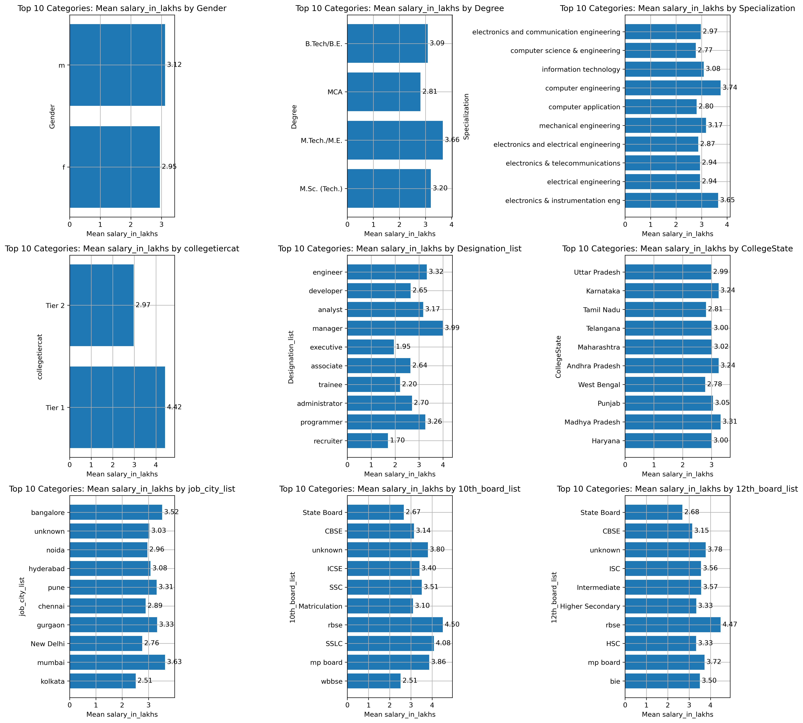
Various Features & Their Relationships With The Target Variable, Salary
Bivariate Analysis Of Salary With Other Categorical Variables

Slide 13
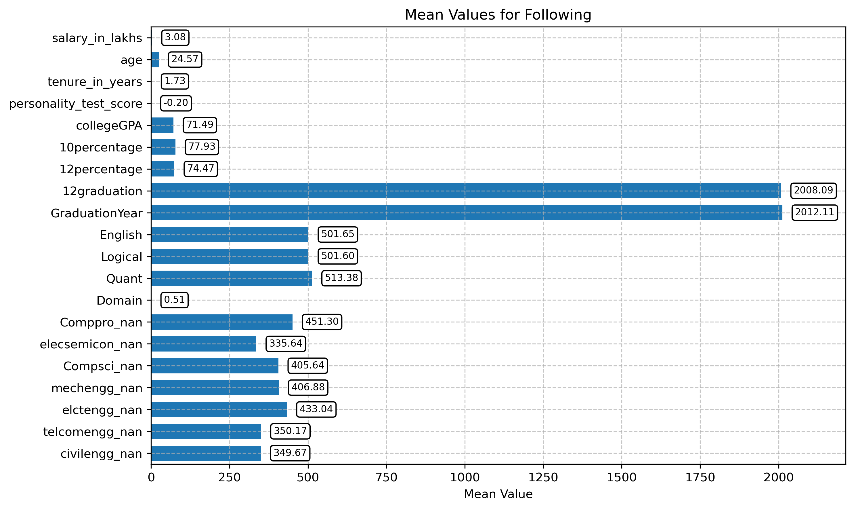
Various Numerical Features & Their Mean Values
Bivariate Analysis Of Salary With Other Numerical Variables

Slide 14
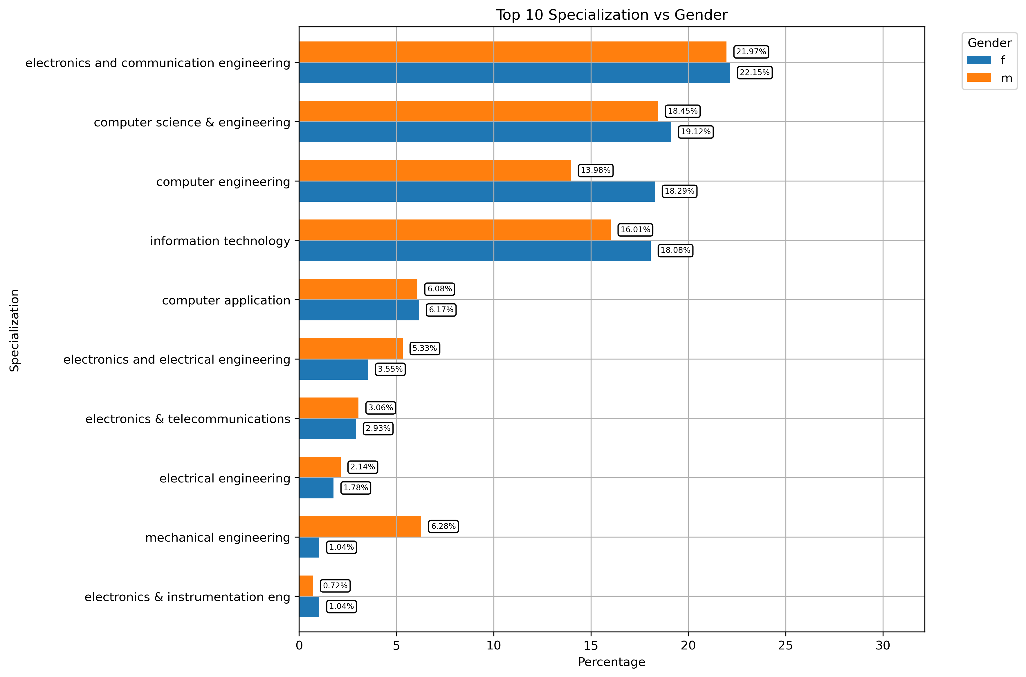
Question
1. Explored the relationship between gender and specialization (Top 10 Specializations)

Slide 15
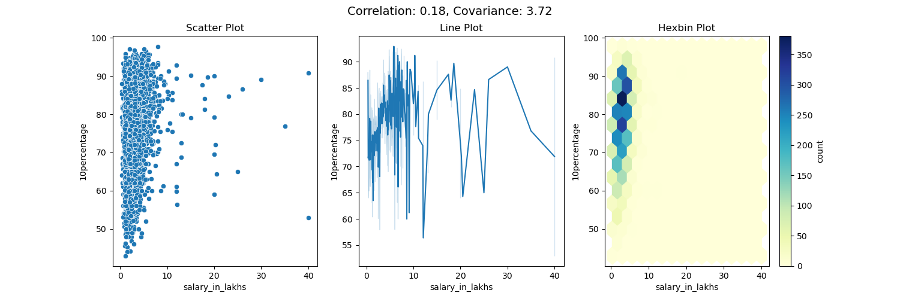
Questions
2. Relationship between education and earning potential (Salary Vs 10th Percentages)

Slide 16
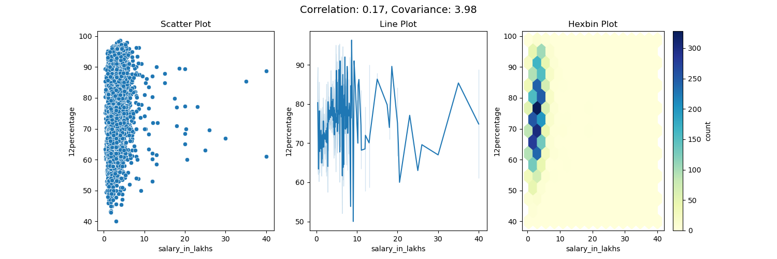
Questions
2. Relationship between education and earning potential (Salary Vs 12th Percentages)

Slide 17
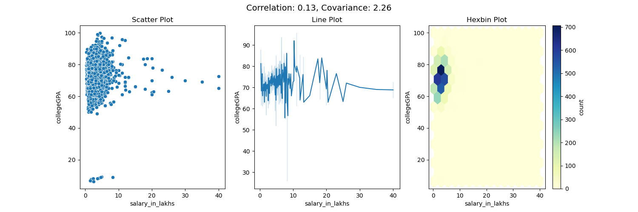
Questions
2. Relationship between education and earning potential (Salary Vs CollegeGPA)

Slide 18
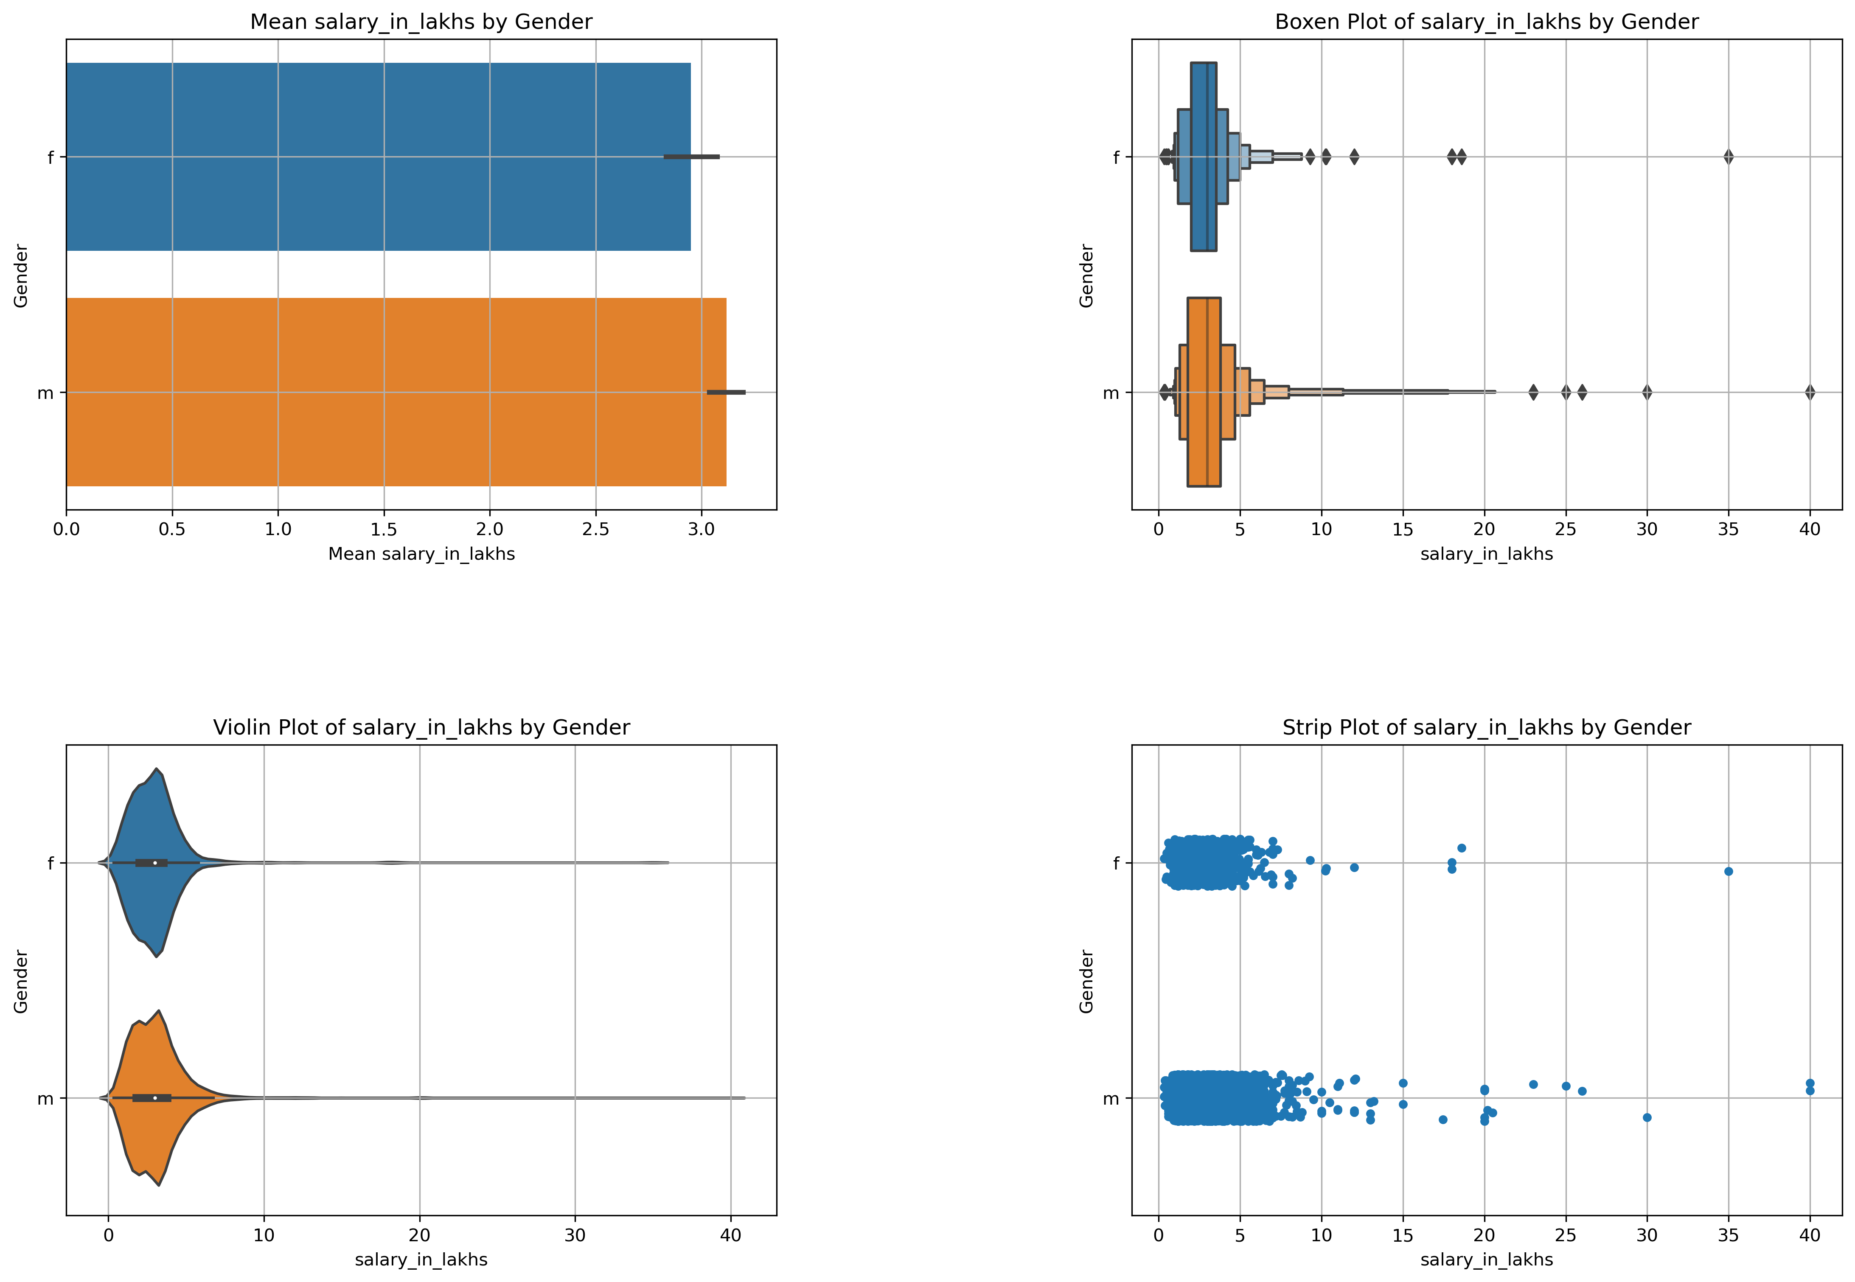
Question
2. Explored the relationship between gender and salary

Slide 19
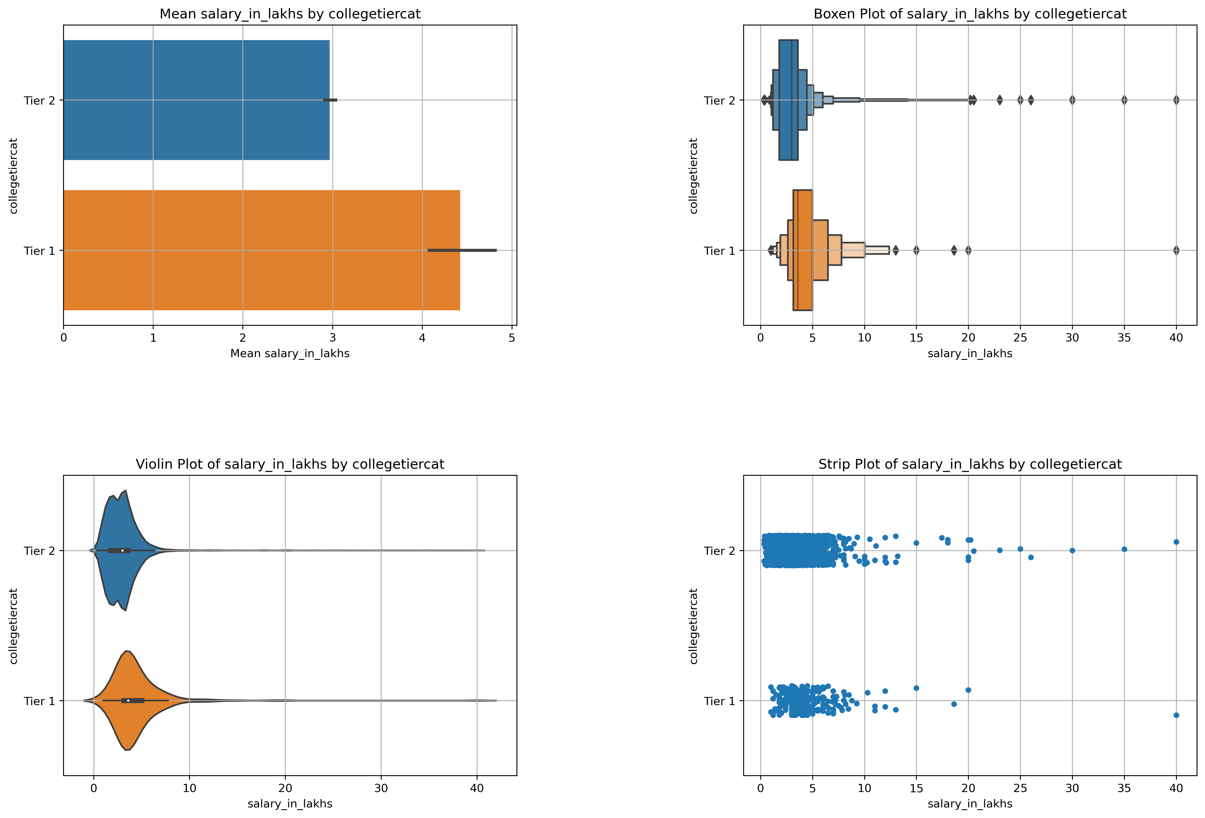
Question
2. Relationship between education and earning potential (Salary Vs CollegeTier)

Slide 20
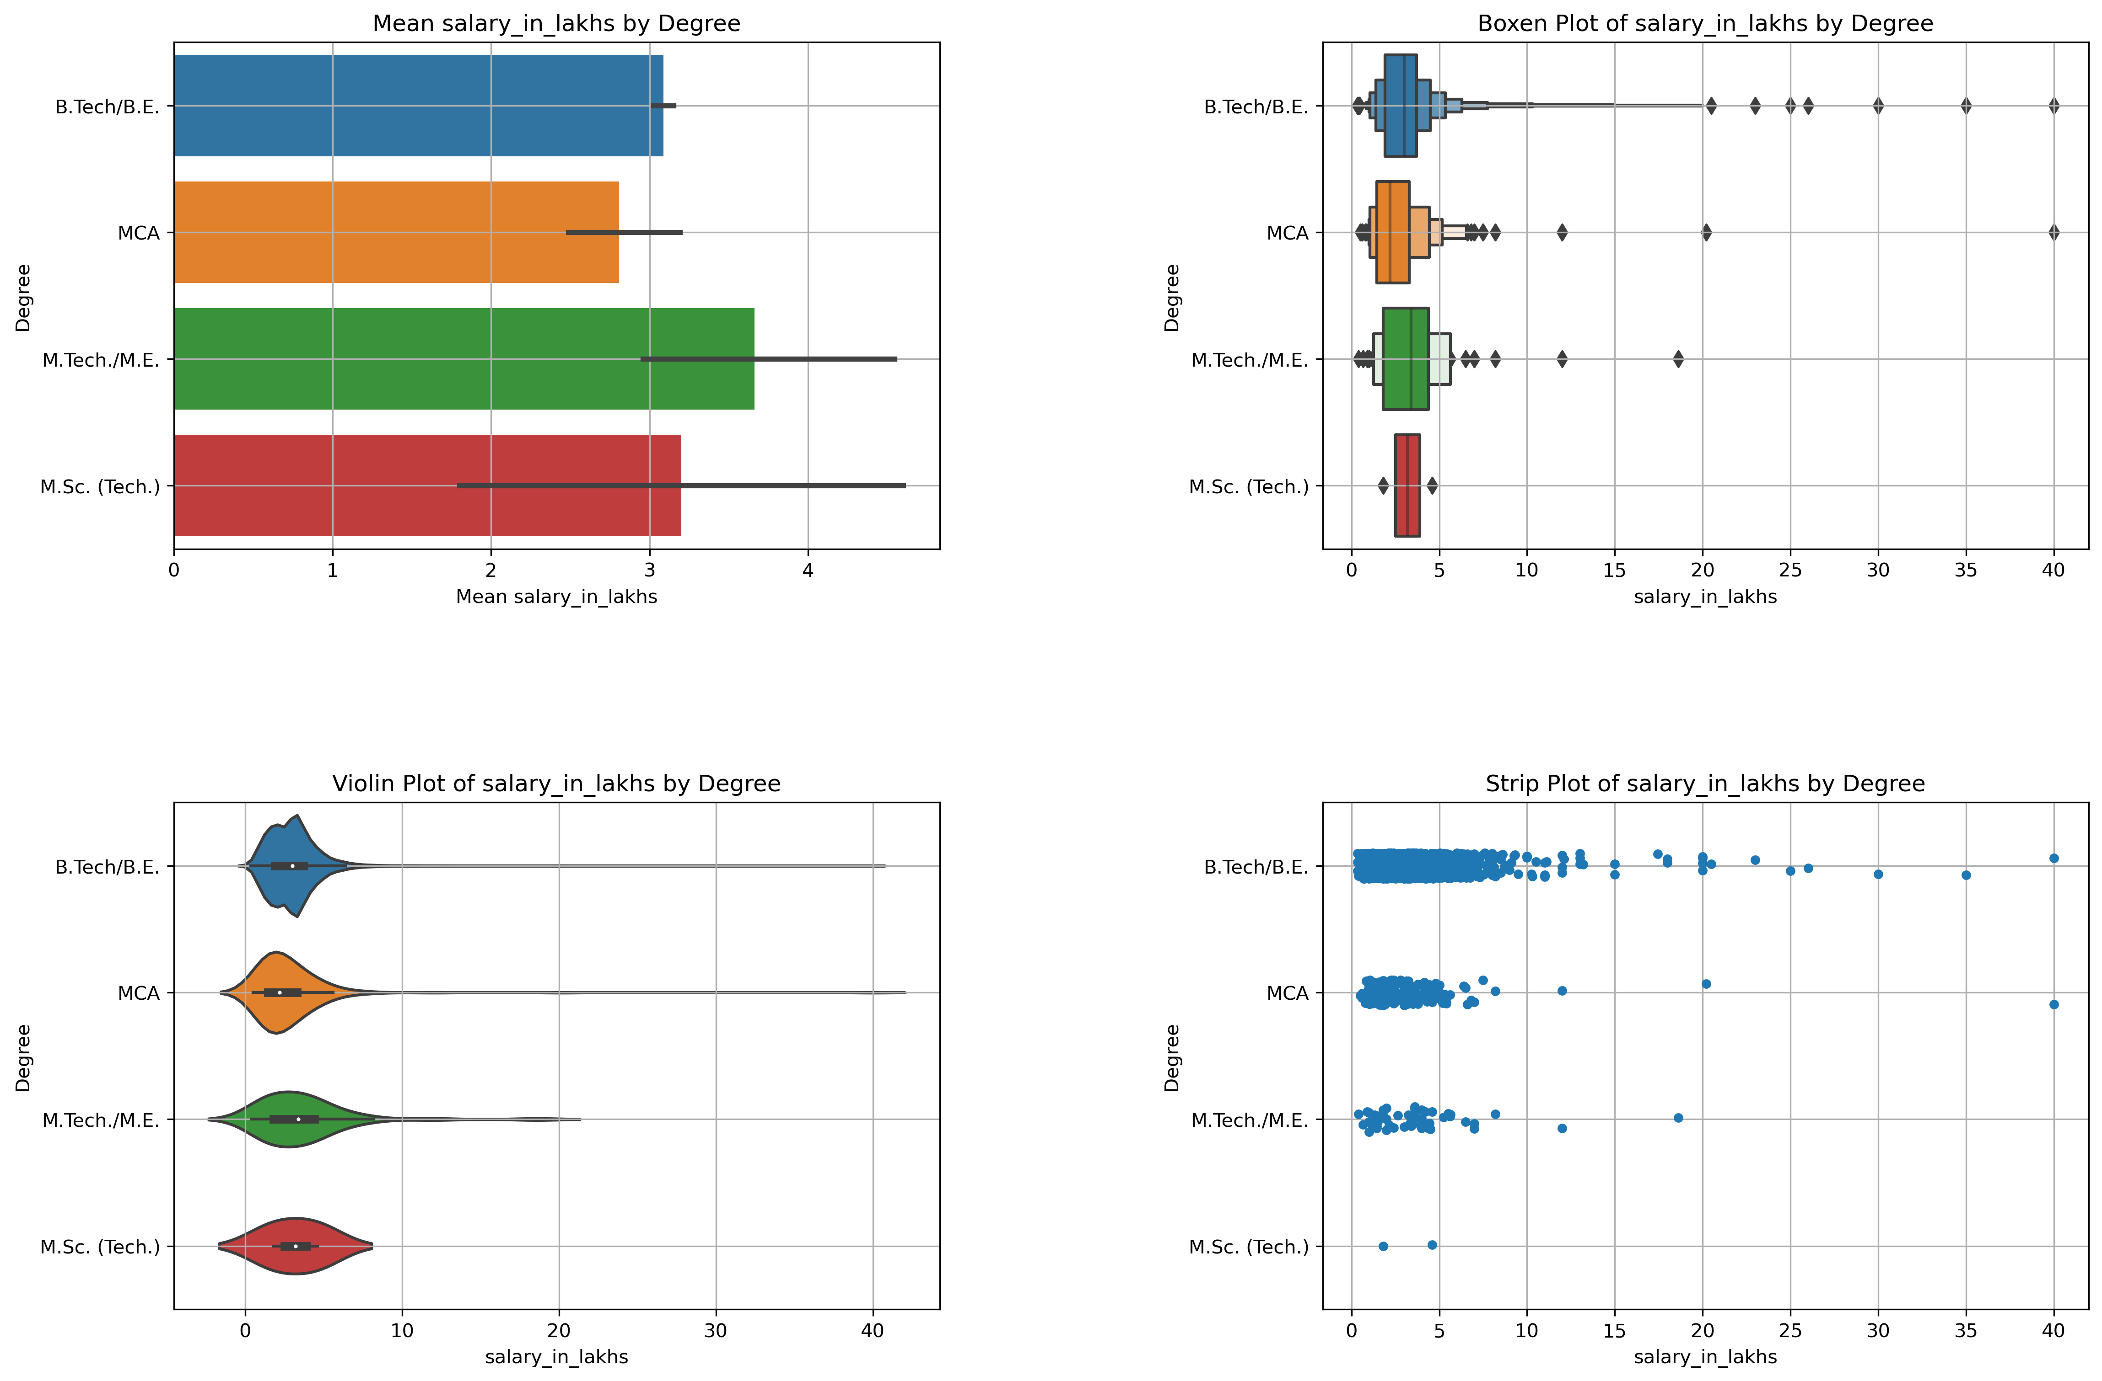
Question
2. Relationship between education and earning potential (Salary Vs Degree)

Slide 21
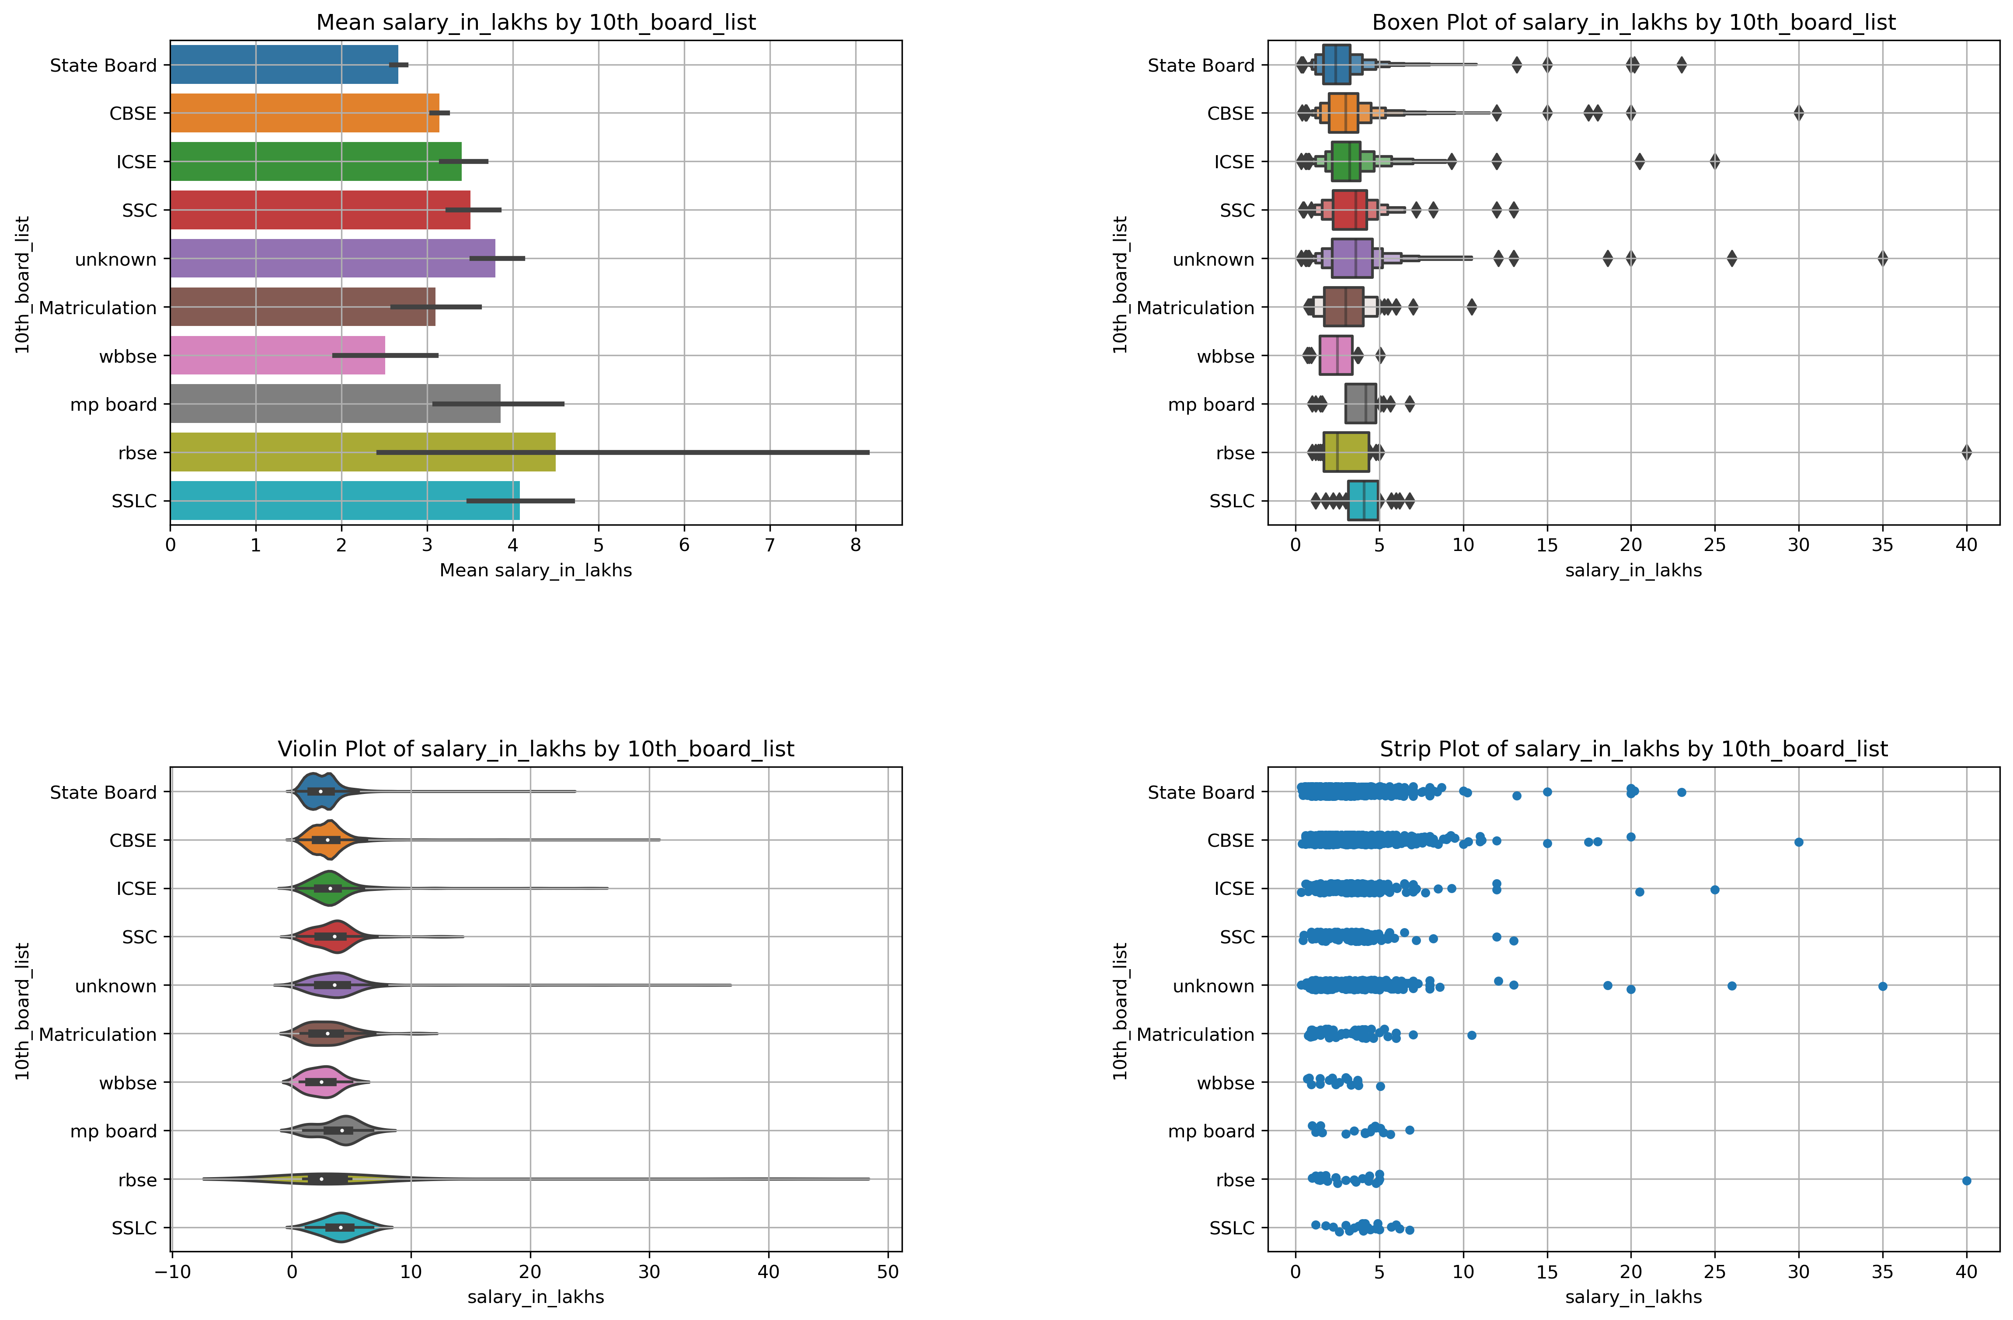
Question
2. Relationship between education and earning potential (Salary Vs 10th Boards) Top10

Slide 22
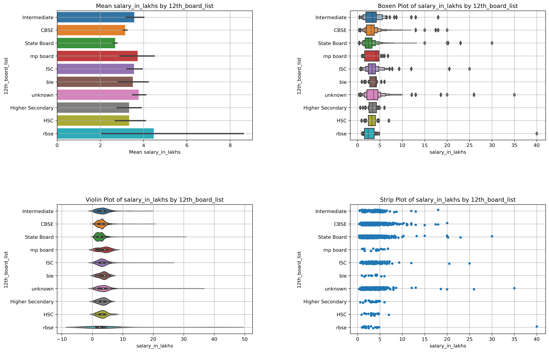
Question
2. Relationship between education and earning potential (Salary Vs 12th Boards) Top 10

Slide 23
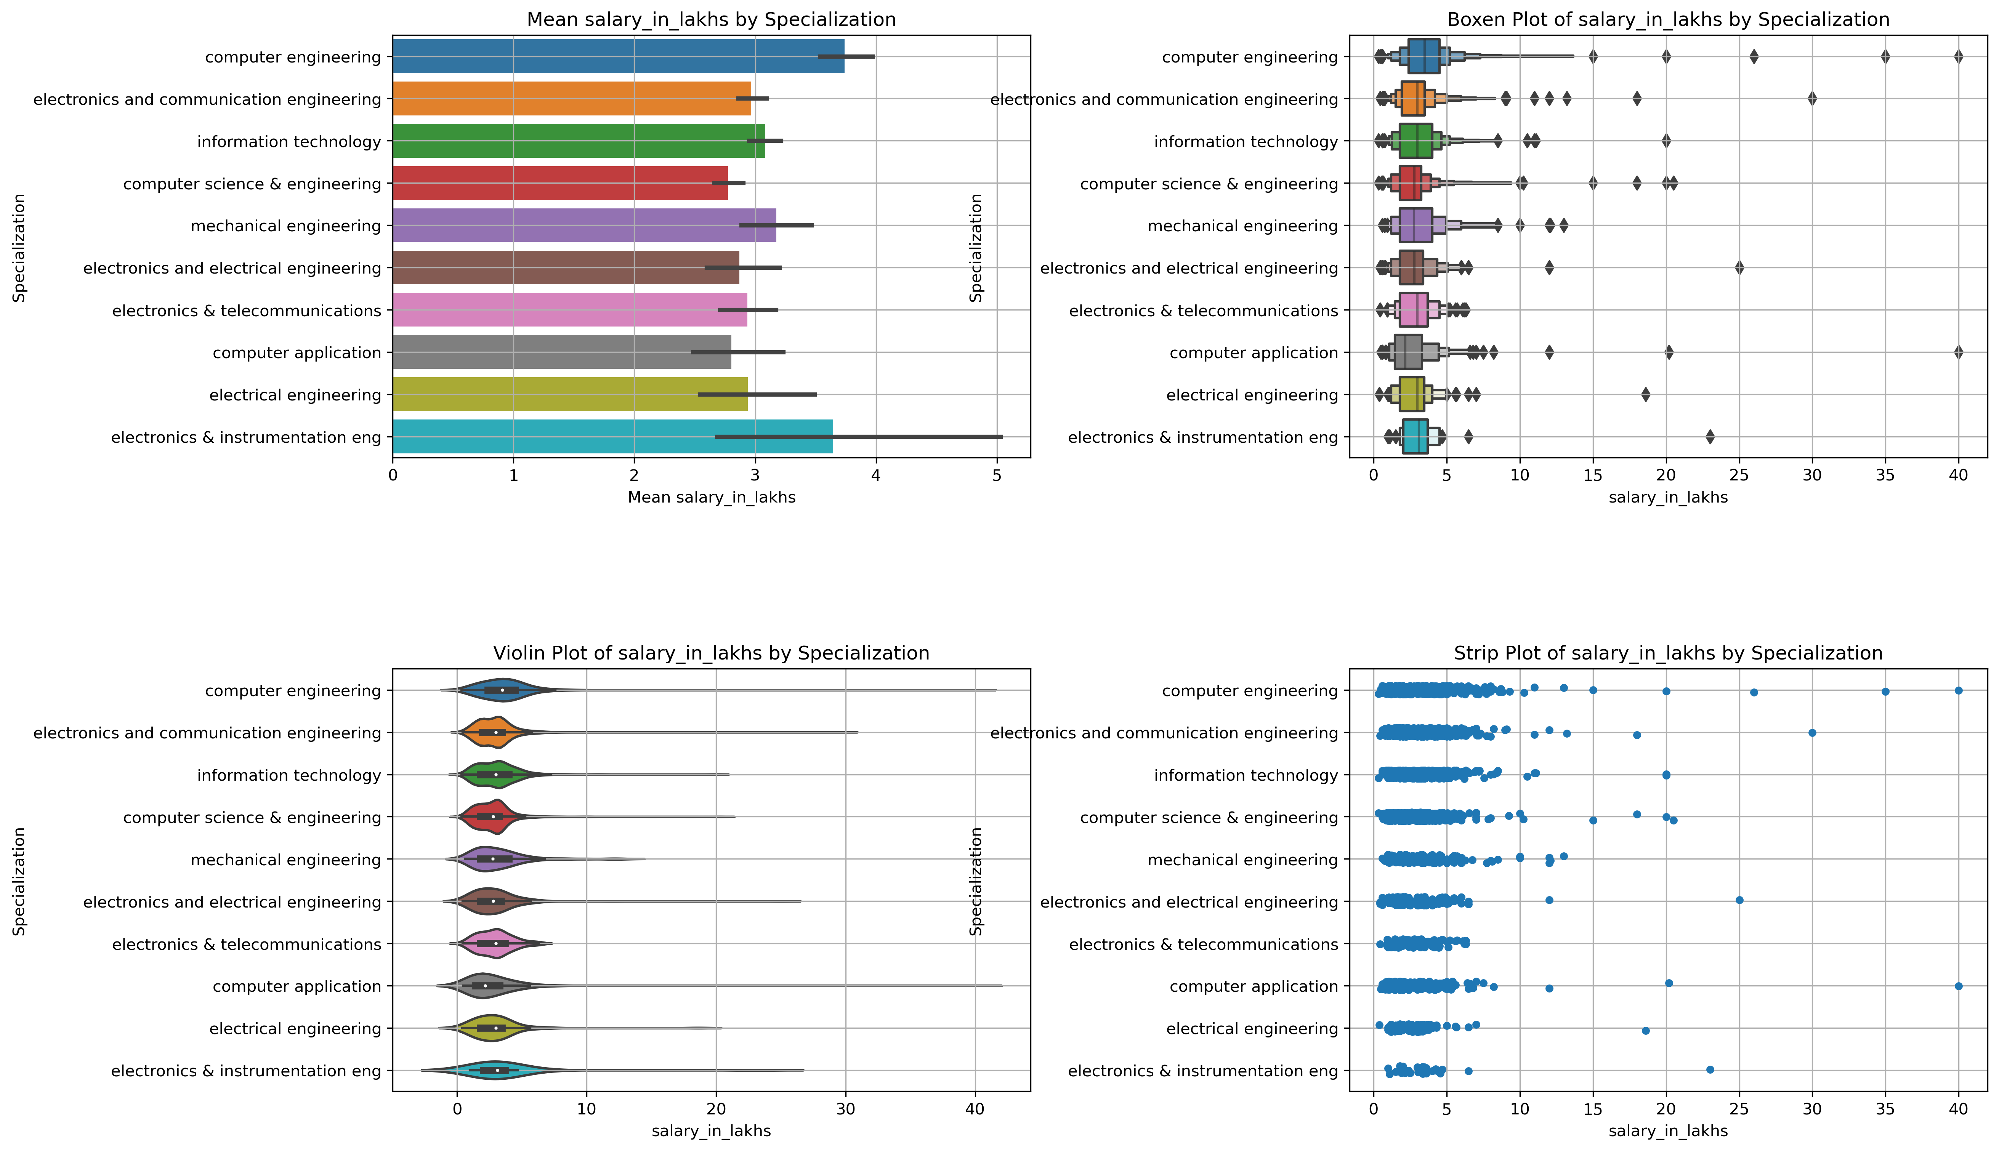
Salary Vs Specializations
Top 10

Slide 24
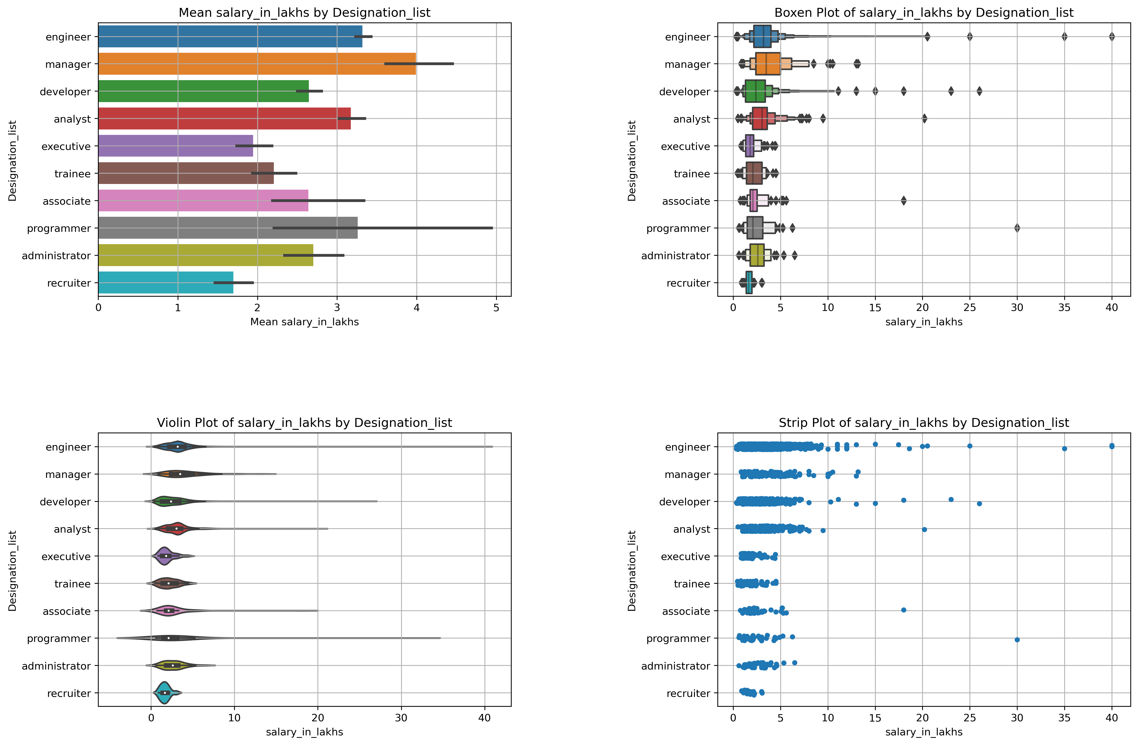
Salary Vs Designations
Top 10

Slide 25
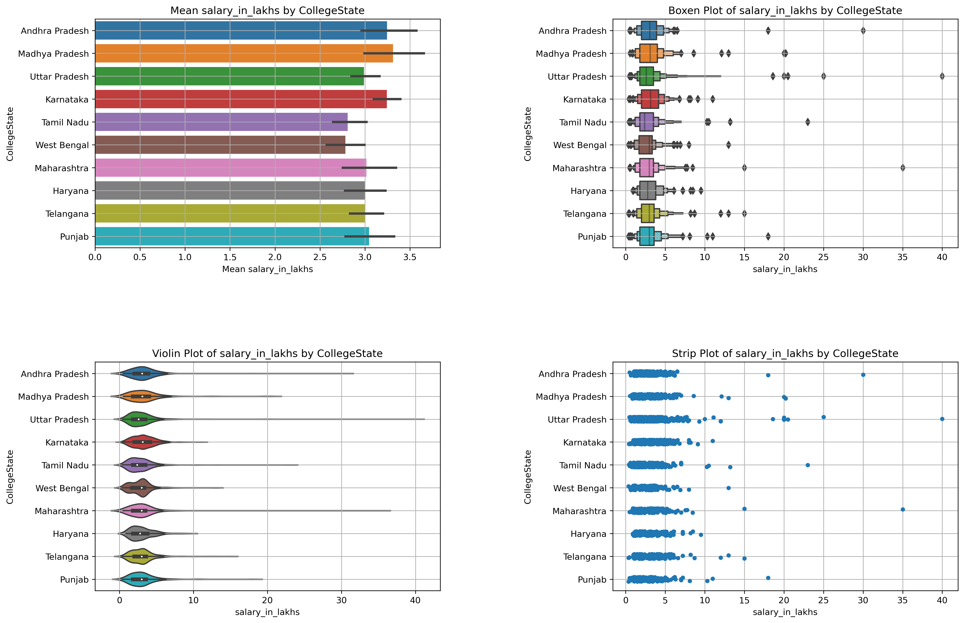
Salary Vs CollegeStates
Top 10

Slide 26
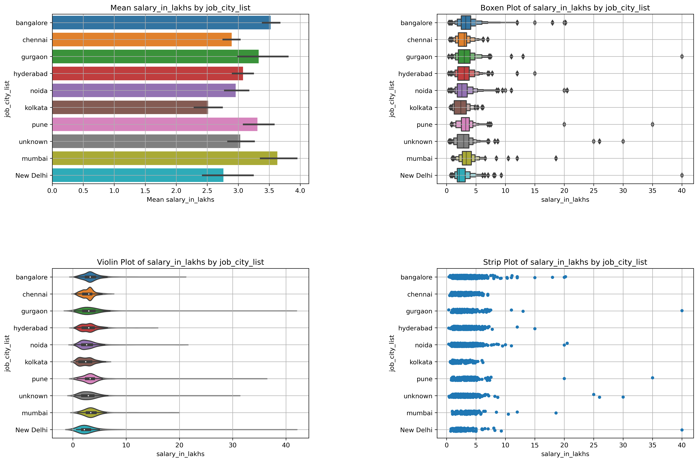
Salary Vs JobCity
Top 10

Slide 27
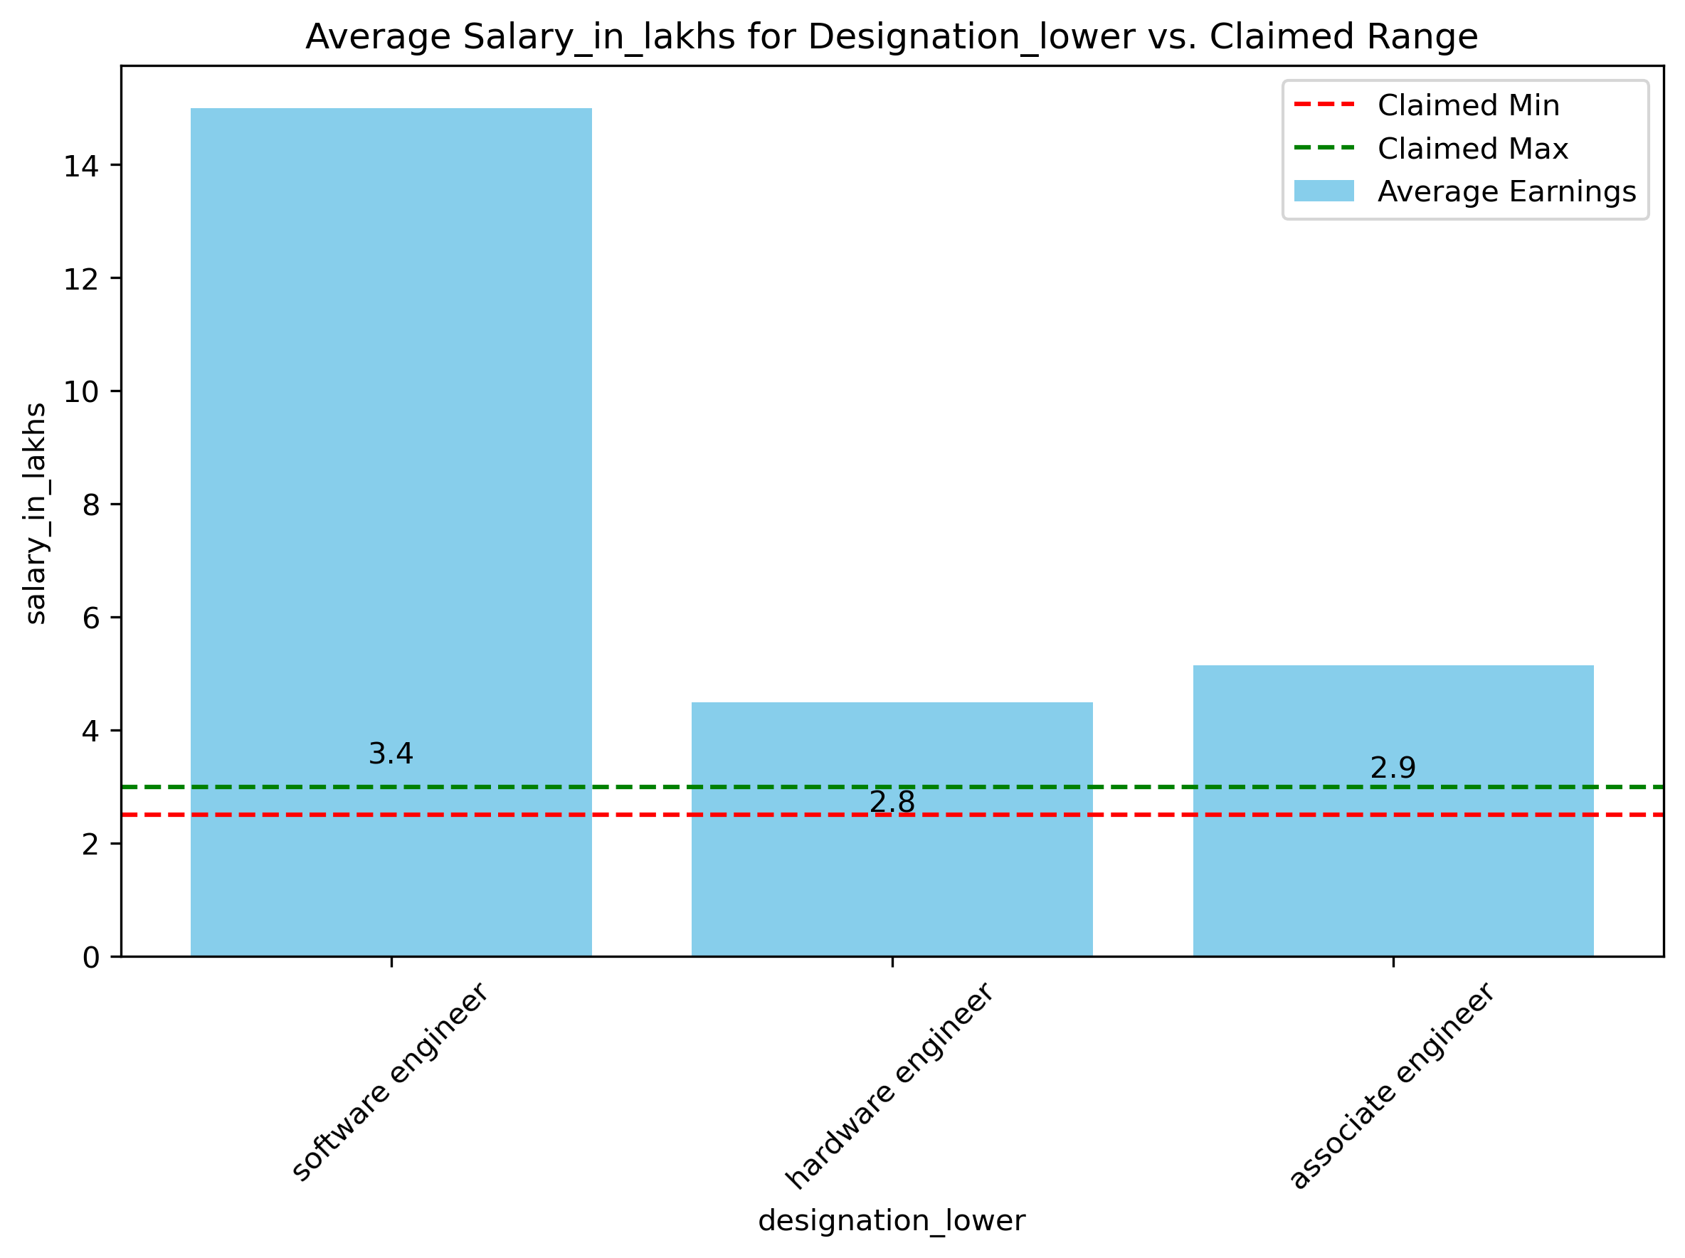
Research Questions
Times of India article dated Jan 18, 2019 states that “After doing your Computer Science Engineering if you take up jobs as a Programming Analyst, Software Engineer, Hardware Engineer and Associate Engineer you can earn up to 2.5-3 lakhs as a fresh graduate.”
Test this claim with the data given to you.
Claim Is True, They Earn More

Slide 28
Conclusion
Successfully conducted data analysis on the AMEO dataset to understand salary determinants for engineering graduates. Key findings and actionable recommendations were derived, empowering graduates with insights for career growth and salary negotiation. Future steps involve refining models and sharing insights for broader impact.
Cognitive Skills and Technical Expertise: Both cognitive skills and technical expertise have a significant impact on salary outcomes for engineering graduates. Continuous skill development in these areas is crucial for enhancing employability and salary prospects.
Personality Traits: Certain personality traits also contribute to salary variations. Building strong communication, leadership, and problem-solving skills can positively influence salary negotiations.
Demographic Factors: Job titles, locations, and industry sectors play a crucial role in determining salary prospects. It's important for graduates to consider these factors when planning their careers.
Predictive Modelling: The developed predictive model accurately estimates salaries based on candidate attributes, providing actionable insights for salary negotiation and career planning.
Impact and Future Directions:
The project's insights can empower engineering graduates to make informed career decisions, negotiate better salary packages, and navigate the competitive job market.
Future directions may include expanding the analysis to include additional variables or exploring industry-specific salary trends for more targeted recommendations.

Slide 29
Experience
Challenges Faced:
Complex Data Structure: Dealing with a diverse range of variables, including continuous and categorical data, required careful preprocessing and analysis.
Communication of Insights: Effectively translating analysis findings into actionable recommendations for diverse stakeholders was essential yet challenging.
Key Learnings:
Importance of Data Quality: Data preprocessing and cleaning are critical for accurate analysis and model development.
Interpretability vs. Complexity: Balancing model complexity with interpretability is crucial for practical application and stakeholder understanding.
Communication Skills: Effectively communicating complex analytical insights to non-technical stakeholders is essential for driving actionable outcomes.
Success Factors:
Rigorous Methodology: Following a structured approach to data analysis and model building ensured robust and reliable results.
Continuous Learning: Embracing a learning mindset and staying updated with industry best practices and advancements enhanced project outcomes.

Slide 30

THANK YOU

